Slide 1
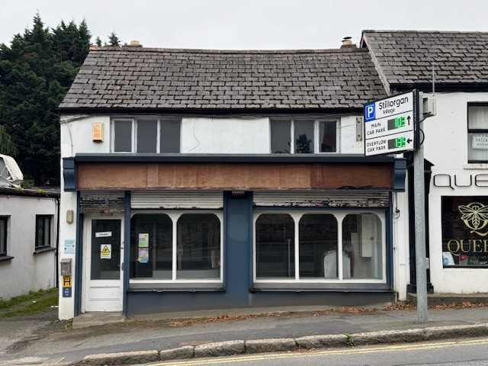

12 The Hill, Stillorgan, Co Dublin, A94 R125 ________________________________________________________________________________________________________________________________________________________
For Sale
Freehold two storey building of c.122 sq.m.
Full vacant possession
Adjacent to new apartment development (Stillorgan Orchard pub Site)
Located opposite new 377 unit apartment development
Established trading location a short distance from Stillorgan S.C.
Suit a variety of uses (subject to p.p.)
____________________________________________________________________________________________________________________________________________________________________
O’MAHONY AUCTIONEERS
T. +353 (0) 1 298 3500 E. property@omahony.ie
www.omahony.ie
2 Willowfield Park, Goatstown, Dublin 14, D14 E6K6.
PSRA no.001493

Slide 2


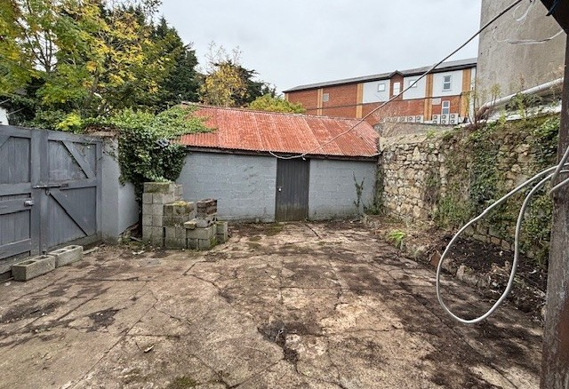
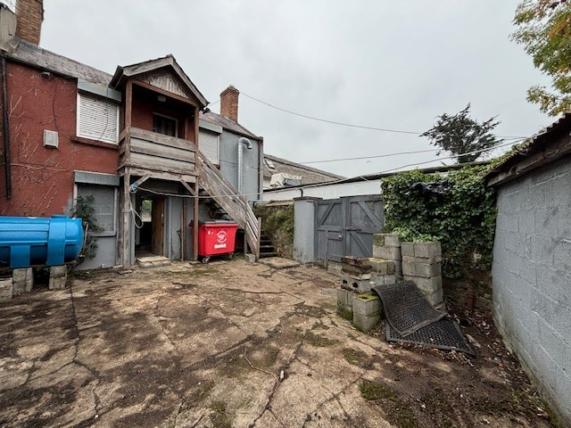
Contact: O’Mahony Auctioneers
T. +353 (0) 1 298 3500 E. property@omahony.ie
www.omahony.ie
Negotiators: Martin O’Mahony, FIPAV. Jennifer O’Mahony, BSc(Hons) MIPAV.
O’Mahony Auctioneers for themselves and for the seller of this property whose agents they are give notice that the introduction and the particulars are intended to give a fair and substantially correct overall description for the guidance of any intending purchaser and do not constitute part of any offer or contract. No responsibility is assumed for the accuracy of individual items. Prospective purchasers ought to seek their own professional advice. All descriptions, dimension areas, references to conditions and necessary permissions for use and occupation and other details are given in good faith, and are believed to be correct, but any intending purchaser should not rely on them as statements or representations of fact but must satisfy themselves by inspection or otherwise as to the correctness of them. Please note we have not tested any apparatus, ﬁxtures, ﬁttings, or services relating to this property. Interested parties must undertake their own investigation into the working order of these items. All measurements are approximate, and photographs & ﬂoorplan/s are provided for guidance only. All interested parties should satisfy themselves by independent veriﬁcation and undertake their own due diligence as to the accuracy of the measurements and overall area as stated and the accuracy of any ﬁxtures and ﬁttings as described and the information above.
Description
Vacant Freehold mixed use two storey commercial / residential unit with full vacant possession, situated in a developing area of residential apartment units, in vibrant Stillorgan Village with its many amenities.
This unit comprises a gross internal area of c.122 sq.m. with a ground floor retail unit of c.63 sq.m. and an overhead residential unit of c.59 sq.m. with its own separate access.
A double gated rear side entrance leads to a yard/parking area (c.62 sq.m.) with access to a large detached storage unit of c.20 sq.m.
The retail unit was previously used as a Bookmakers Shop and more recently as a Dry Cleaners.
This prime unit is located adjacent to the old Stillorgan Orchard Pub which now has F.P.P for 41 Apartments together with ground floor Commercial Units. Directly opposite the property is the former Blakes / Esmonde Motors Site, which has F.P.P. for a 377 ‘build to rent’ apartments together with a commercial element.
Suitable for a variety of uses (subject to PP).
● Retail Shop of c.63 sq.m. (c.681 sq.ft.)
● Overhead 2 bed Residential unit c.59 sq.m. (c.636 sq.ft.)
● Vacant possession of entire
● Shop frontage of c.6.5m (c.21’4”)
● Side entrance
● Double gates to rear yard
● Side Access to Store building of c.20 sq.m. (c.218 sq.ft.)
● Rear access to first floor Residential unit.
● Freehold Title
● Prime location
● Exciting developing location
BER
Commerical B3
BER no. 800903692. EPI 1820.15 kWh/m²/yr 0.91
Residential G
BER no. 102085917. EPI: 488.05 kWh/m²/yr .
VAT
We are advised that VAT does not apply to this sale.
Viewing
Strictly and only by prior appointment with our office.
Note:
Any intended purchaser will need to satisfy themselves as to the exact area of the subject property, and the details provided herewith.

